Slide 1
Matrices

Slide 2



What Is a Matrix?
Informally: A matrix is a two-dimensional array of numbers. A matrix with $m$ rows and $n$ columns is called an $m×n$ matrix. If $m=n$ the matrix is called a square matrix.
Example
$$A=\left[\begin{matrix}1 & \begin{matrix}0 & 4\end{matrix} \\ \begin{matrix}2 \\ \begin{matrix}3 \\ 0\end{matrix}\end{matrix} & \begin{matrix}\begin{matrix}1 \\ \begin{matrix}1 \\ 2\end{matrix}\end{matrix} & \begin{matrix}1 \\ \begin{matrix}0 \\ 2\end{matrix}\end{matrix}\end{matrix}\end{matrix}\right]$$
This matrix is a $4×3$ matrix.

Slide 3
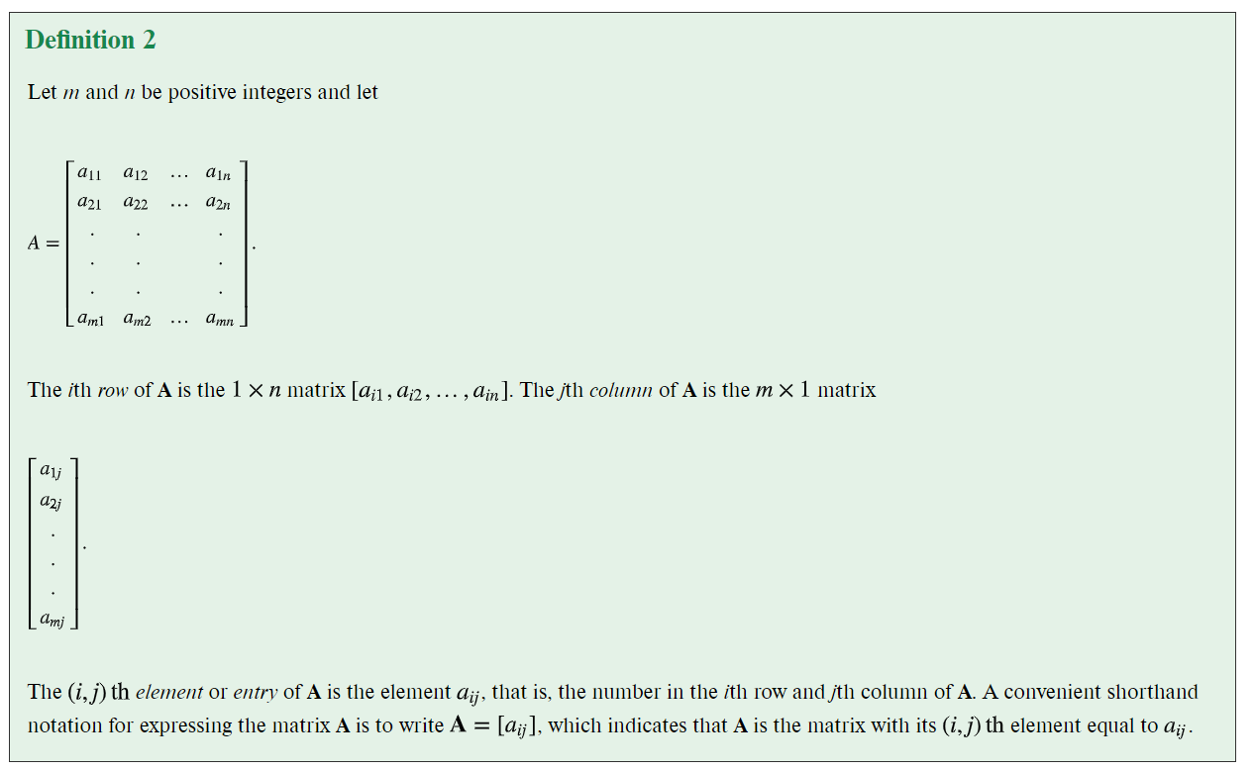

Slide 4
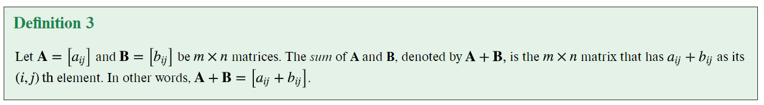
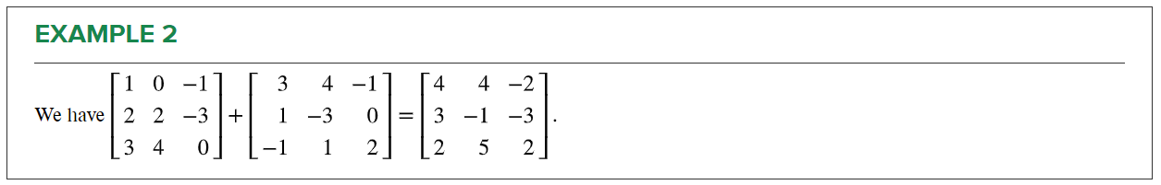
Matrix Addition

Slide 5
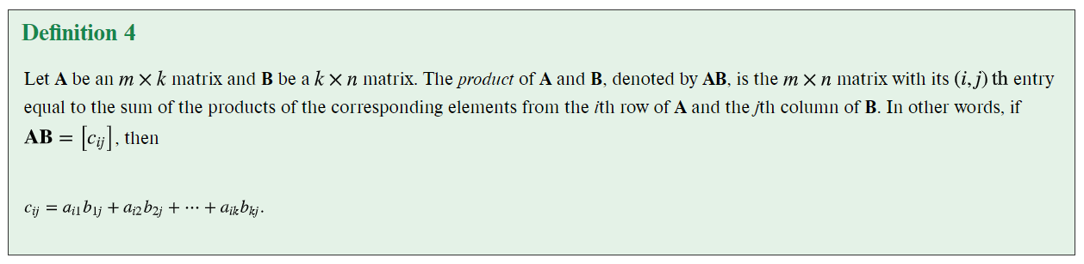

Matrix Multiplication

Slide 6
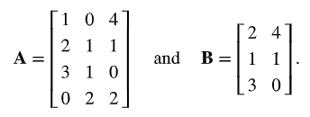
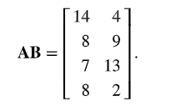
Matrix Multiplication: Example

Slide 7


Matrix Multiplication: More Examples

Slide 8
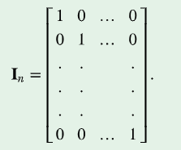


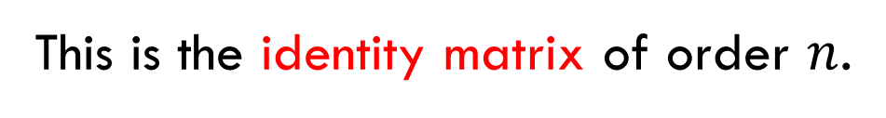
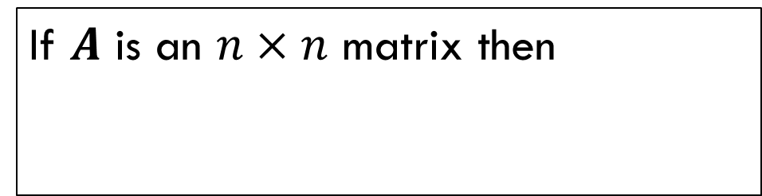
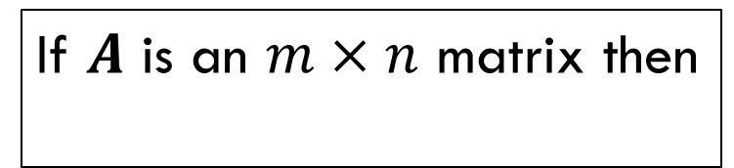
Powers of Matrices
This is the identity matrix of order $n$.
If $A$ is an $n×n$ matrix then
If $A$ is an $m×n$ matrix then

Slide 9
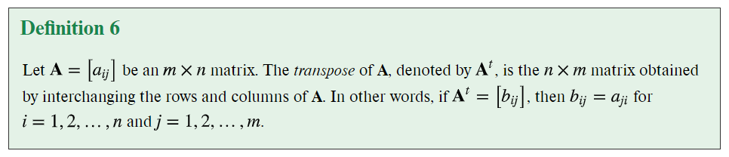
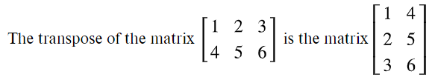
Transposes of Matrices
Example

Slide 10
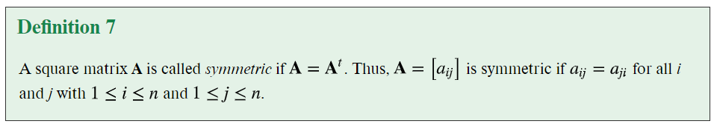
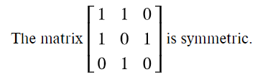
Symmetric Matrices
Example

Slide 11
Exercises

Slide 12


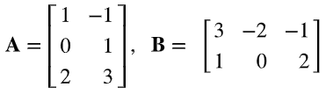
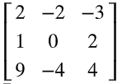
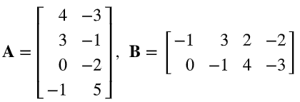
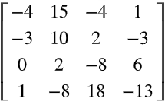

Find the Product $AB$
Answer:
Answer:
Answer:

Slide 13
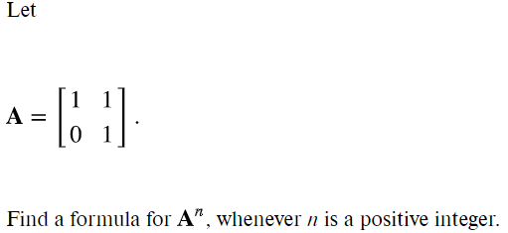

Answer:

